Slide 1

Welcome to the Riot API Bootcamp!
Know more, win more.

Slide 2








What is the purpose of this course?
Learning to use the Riot API is a bit of a struggle. There's very few resources out there and they're not very structured.
“The Riot API Bootcamp Course is designed to take you from no knowledge up to building your own app.”

Slide 3




Who am i?
Karl, Rocket Scientist & Data Analyst
Past work and collaborations:
Cloud 9
NASA
Wells Fargo
Mozilla
Lockheed Martin
Air Force Research Lab
Siemens, GSK
Experience in everything from AI/ML to jet engine design
“Solve difficult problems with novel methods, by any means necessary”
RebirthNA#2359
@LoL-Genius
417devops@gmail.com

Slide 4
Riot API Bootcamp syllabus
Basics (Python, GitHub, Notepad++)
Resources to get started
Setting up an environment
Downloading GitHub repos
JSON explanation & Notepad++ example
Project: read csv file, convert to data frame, create graphs
Riot API introduction
What is an API?
Getting access & Registering your App
What end points are there/what data is available?
Explanation of puuid/account name
Project: make an API call on the website & download the data
Automating API interactions
Introduction to libraries (Cassiopeia, Riot Watcher)
Getting help (documentation, Discord)
Project: automate an API call using a library
Single Endpoint Data
Use case explanation (e.g., in-depth match analysis, leaderboards)
Code example- getting challenger leaderboard
Project: request last 25 games for an account and determine the most common champion(s)
Large Scale Data Collection
Use case explanation (e.g., match history of top 50 players)
Setting up a process pipeline
Comparing 1 file approach vs. functions across files approach
Project: determine number of roles (TOP, MID, etc) on the challenger ladder using the last 5 games
5 Modules covering core topics Project at the end of each

Slide 5
Module 5: Large Scale Data Collection
Riot API BOOTCAMP
Slide Deck

Slide 6

Module 5: Large Scale Data Collection
Single Endpoint Data
Use case explanation
Setting up a process pipeline
Comparing 1 file approach vs. functions across files approach
Project: determine number of roles (TOP, MID, etc) on the challenger ladder using the last 5 games
Let’s Dive In

Slide 7
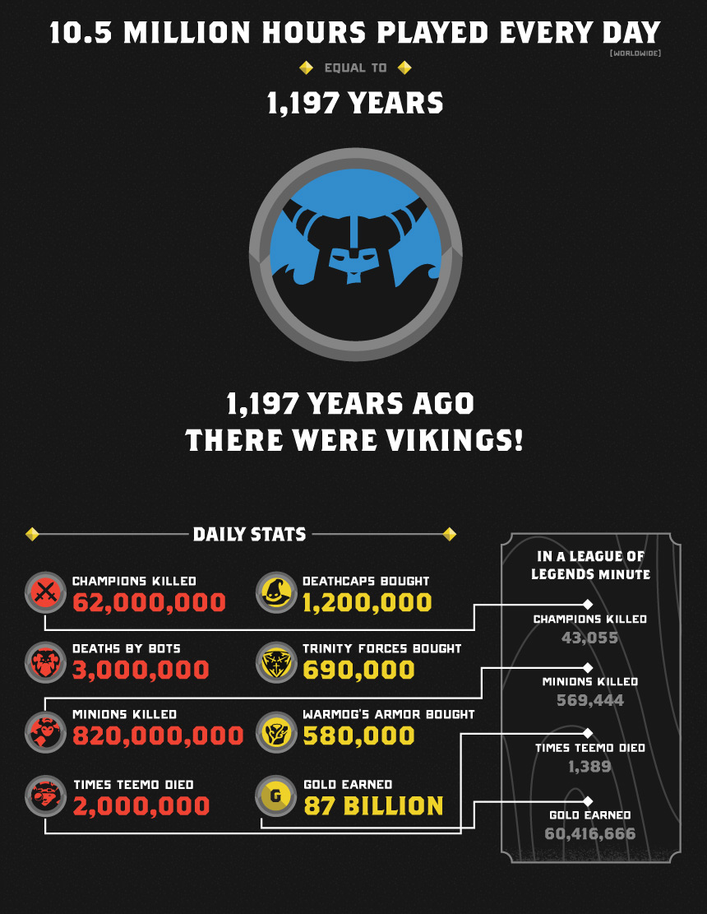
What is large Scale data collection?
Previously we looked at small data
1 account
1-2 end points
What if we wanted to get an idea of large trends?
What champions are popular?
How are different roles represented in different ranks?
Is there a new build?
This is a lot of data!
Just how big is this?
2020 World Championship peaked at 46,067,896 viewers
Getting the last 20 games for these players is 921 million games
1 match stat file takes up about 115 KB, storing the game data would take up 101,000 GB
If each request takes 0.5 s, that will take 14.6 years
This is what Riot released in 2016. League now has ~180 million monthly players, more than 10x the above info

Slide 8
Process Pipeline
Define the relevant data:
What data do I want to collect?
List of players
Identify API endpoints:
Where is the data coming from?
Account-V1
Determine the data flow:
In what order am I collecting the data?
Account info
List of matches
Pro matches
Timeframe
League-V4
Match-V5
Etc.
Match history
Match stats
Check for efficiency improvements: How can I minimize the amount of data requested?
Info by match instead of player
Discarding useless info
Preload static files
Because we have so much data, we need a clean process to automatically get the information!

Slide 9

Memory efficiency example
/lol/match/v5/matches/{matchId}
From Project 4
Returns MatchDTO object
Looking at game time

Slide 10
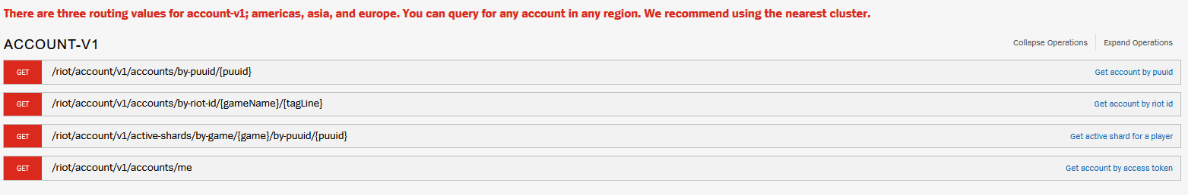
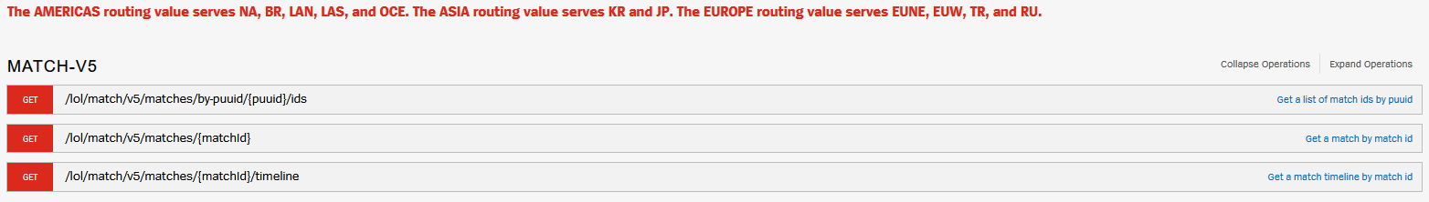
Setting up external functions
Request account info
Request match history
Request match info for each match
/riot/account/v1/accounts/by-riot-id/{gameName}/{tagLine}
/lol/match/v5/matches/by-puuid/{puuid}/ids
/lol/match/v5/matches/{matchId}

Slide 11

Project-5 Info
Task List:
Project: determine number of roles (TOP, MID, etc) on the challenger ladder using the last 5 games
Let’s Dive In

Slide 12


Questions?
Contact me
It is my hope that this course is easy to understand and follow
Have a question or want additional details? Just reach out!
If you want to know more about my work (LoL Genius) or have questions about something you’re building, LMK!

